Slide 1
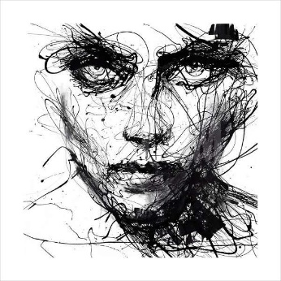
I B A R T 2
Mr. Black
Goals
Think hard, be open minded, and work to better your skills as an artist
Create Art using advanced application of multiple medias and techniques
Create artworks that display a conceptual component
Analyze artworks from the past to present through written and verbal discussions
Establish how to create a “Coherent Body of Work”
Work beyond normal class time
Complete all requirements of the IB Art Portfolio
Supplies that are needed everyday
(please have these within the first week of class)
A pencil with eraser
Sketchbook
Portfolio – 12” x 18” or larger – bought or made
Students are also welcome to bring their own pastels, colored pencils, paint, etc. These are not required though.
More information and Student Gallery
@
Hardawayart.com
Total Points Grading
Major Projects – 200 points
Daily Work – 100 points
All projects have deadlines. Projects loose ten points a day they are late. Homework may not be turned in late.
Contact:
Please contact me any time you have questions or concerns.
Scott Black – Black.Christopher.S@
muscogee.k12.ga.us
Effort is Everything in Art. As a result, you will be expected to give your personal best everyday. You will also receive a participation grade that is an evaluation of your daily involvement in the class.
The Golden Rule of the Art Room is Do Not Disrupt the Creative Process
All School rules apply in here as well.
Respect….everything and everyone.
Work with quiet focus and clean up after yourself.
Stop the Clock Pass
Date _____________ Project _______________Signature __________________
Date _____________ Project _______________Signature __________________
Date _____________ Project _______________Signature __________________
__________________________­­_________ __________________________________
Student’s signature Parent’s signature

Slide 2
IB Art Program Overview
Comparative Study: 20% (External)
This is the research component of IB Art. It is not an essay though. Here you will create a study of multiple artworks. You will write, add images, and even draw to illustrate your ideas. These slides can be created on the computer or in your sketchbook first and then scanned into a slide. You will be expected to analyze formal qualities, interpret function and purpose, evaluate cultural significance, make comparisons and connections, and use subject specific language. Information may be typed or neatly printed. Cite everything!!!!
Requirements: --SL – 10 – 15 Power Point Slides (Screens) HL – 10 – 15 Slides + 3 connection slides --Compare at least three artworks, two of which must be by different artists and also contrasting context (local, national, international) ---Bibliography at the end
Process Portfolio 40% (External)
This section displays your experimentation and process as an artist. Here you will show art from your sketchbook, practice pieces and works that you do not include in your Exhibition. The goal here is to show a wide range of experiences with multiple media, styles and approaches. It will also include your commentary explaining what is being shown, goals, and reflections. Cite all sources throughout.
Requirements: -- SL 9 – 18 Power Point Slides (Screens) HL – 13 – 25 Slides --SL – 2 or more media from 2 or more columns below HL – 3 or more media from 2 or more --Add commentary
Exhibition 40% (Internal)
The exhibition will contain your best pieces. These works should display technical competence, conceptual qualities, and curatorial practice. The majority of which should illustrate your concentration.
Requirements: --SL – 4 – 7 Artworks HL – 8– 11 Artworks --Curatorial Rational – SL – 400 words max HL – 700 words max --Title, Size, Medium and a brief explanation of each piece (500 characters max)

