Slide 1
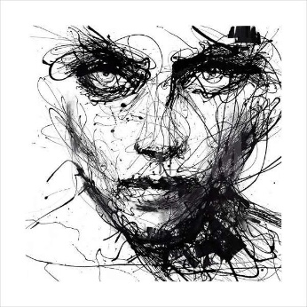
A R T 1
Mr. Black
Goals
Think hard, be open minded, and work to better your skills as an artist
Understand and use the language of Art in writings and discussions
Create using multiple medias and techniques
Work with a broad range of concepts and subject matters
Analyze artworks from the past to present
Engage in problem solving activities
Supplies that are needed everyday
(please have these within the first week of class)
A pencil with eraser
Sketchbook
Portfolio – 12” x 18” or larger – bought or made
Students are also welcome to bring their own pastels, colored pencils, paint, etc. These are not required though.
More information and Student Gallery
@
Hardawayart.com
Total Points Grading
Major Projects – 200 points
Daily Work – 100 points
All projects have deadlines. Projects loose ten points a day they are late. Homework may not be turned in late.
Contact:
Please contact me any time you have questions or concerns.
Scott Black – Black.Christopher.S@
muscogee.k12.ga.us
Effort is Everything in Art. As a result, you will be expected to give your personal best everyday. You will also receive a participation grade that is an evaluation of your daily involvement in the class.
The Golden Rule of the Art Room is Do Not Disrupt the Creative Process
All School rules apply in here as well.
Respect….everything and everyone.
Work with quiet focus and clean up after yourself.
Stop the Clock Pass
Date _____________ Project _______________Signature __________________
Date _____________ Project _______________Signature __________________
Date _____________ Project _______________Signature __________________
__________________________­­_________ __________________________________
Student’s signature Parent’s signature

